Slide 1

Hufflepuff – Complexity day
Members – Magdalena, Alessio, Gavaskar and Josh

Slide 2
Overview
Code simplified
1,000 data:
Scraped
Cleaned and formatted
All previous work adjusted to function with new CSV file
Allocated dedicated GitHub manger
Less confusion
More productivity
Notes:
We’ve streamlined the code, everything is shorter and sweeter.
All data has been scraped, cleaned and formatted. Our delays and blocks were gone from the off set today.
Got GitHub organized, its tough to deal with something as delicate as GitHub branches with a team, so we decided to allocate a GitHub manager to keep things in check.

Slide 3
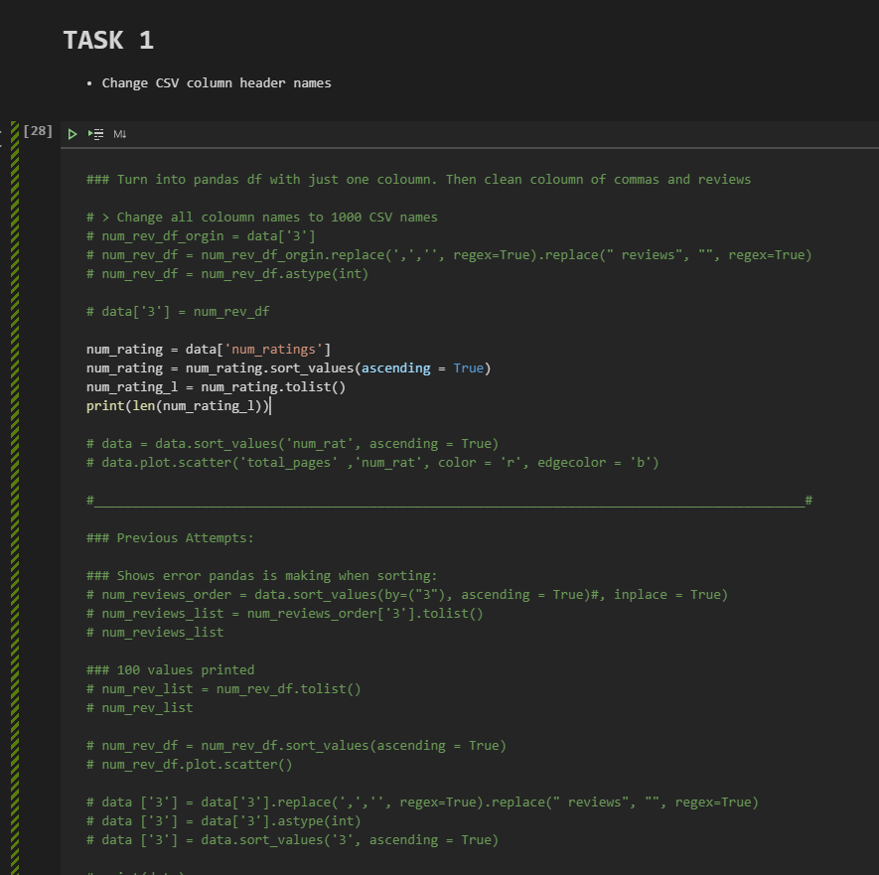
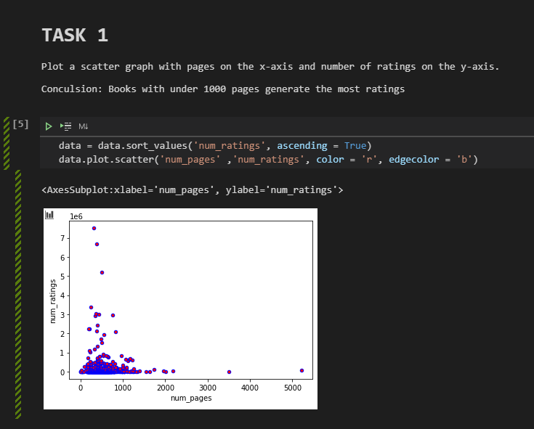
Complex -> Concise
Before
After
Notes:
Best example of overly messy and complex code is mine, the before snippet was me trying to clean the original data set we had,
then replacing the CSV column to then work.
Today we had a beautiful clean data set, and the code could come down to 2 simple lines. From complex to concise

Slide 4
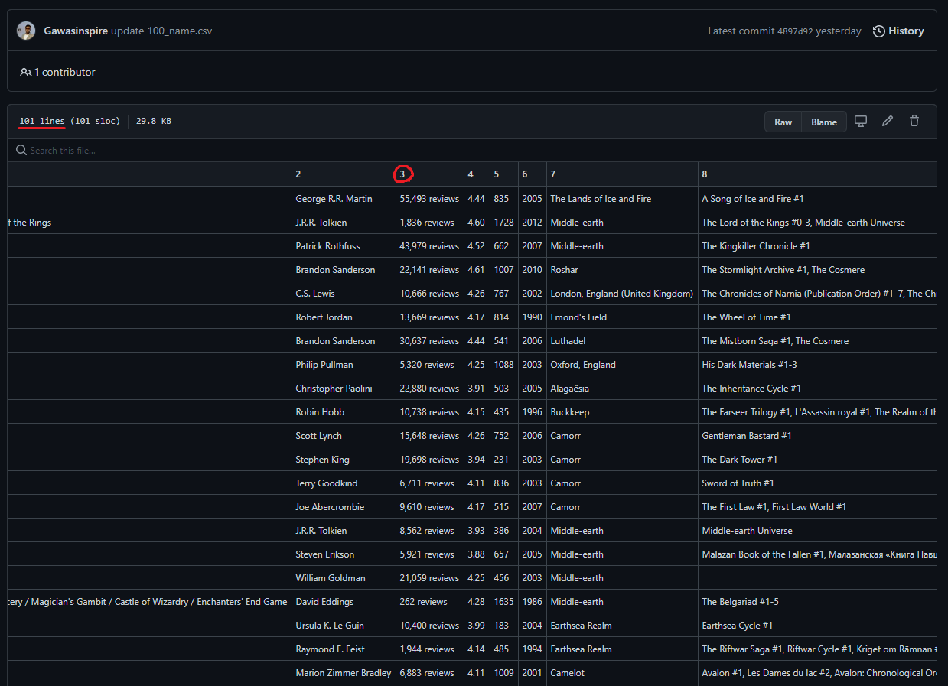
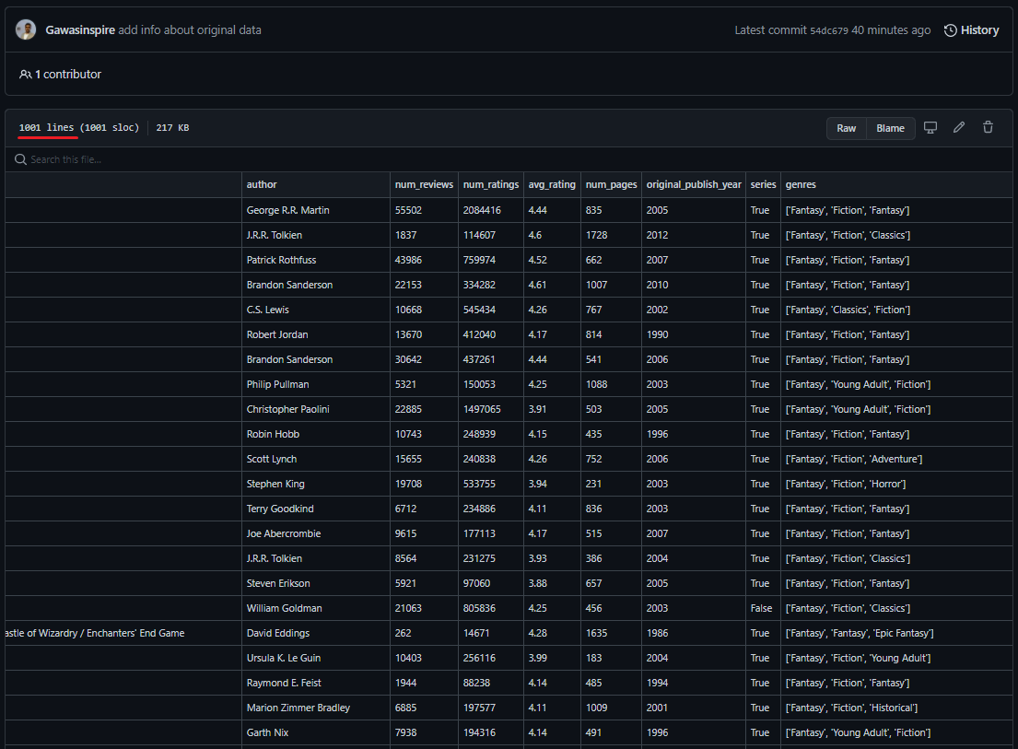
100 Data -> 1,000 Data
100 Rows CSV Demo
Numbered columns
Column 3 was string data (uncleaned)
Missing number of ratings column
1,000 Rows CSV
Labelled columns
Column 3 are now viewed as numbers
Number of ratings column added
Notes:
Before today we were working with a limited data set that had some missing and uncleaned information.
With the amazing work of our scrapers we started the day strong with all scarping related setbacks resolved.
Not only did we have all the data but it was cleaned and ready for us modify our work to have it fit with the new column names and information.

Slide 5
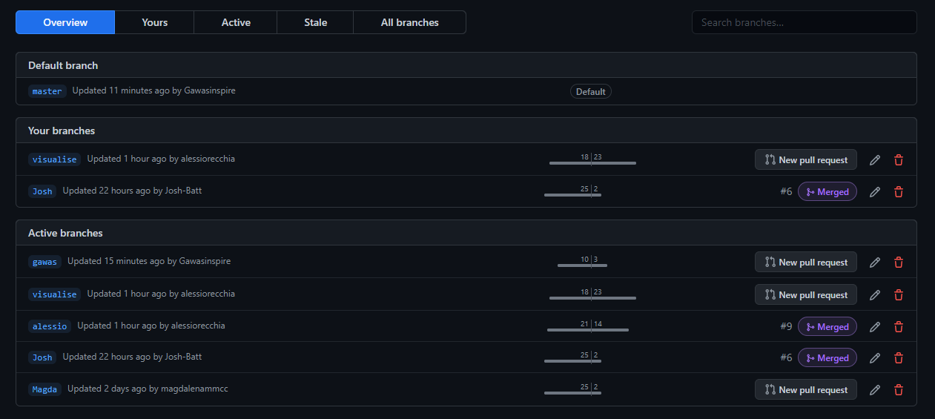
GitHub Management
Overview of a GitHub managers role:
Keeps our project aligned, can manipulate the final folders content -> Leads to less mistakes
Project tab management means nothing gets forgotten. Knows what needs to be done and who's doing what
Notes:
The day wouldn’t have gone so smoothly if it wasn’t for this key point.
The allocation of a GitHub manger.
This person will be the one that keeps your whole project on track.
Once we started working with the full data set and finalized work was ready to be uploaded to GitHub,
the manger made sure no work was missing by using the projects feature and most importaly,
no merge conflicts where generated with the main branch.
They kept ontop of the whole projects track and made sure nothing crashed along the way with success.
A vital role added to the team.

Slide 6
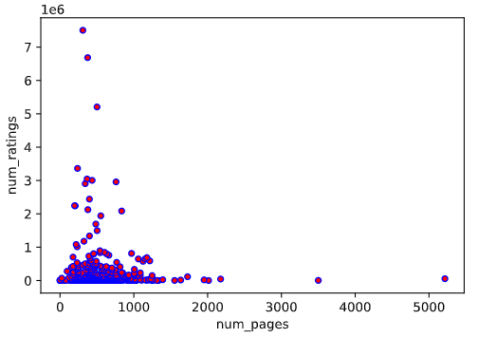
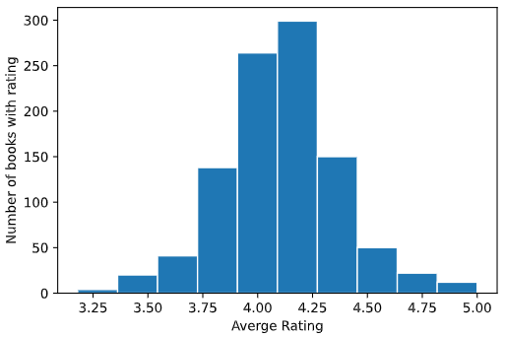
Scatter Plot – Number of pages against number of ratings
Histogram Plot – Average ratings
Notes:
Exploratory data analysis:
Scatter plot = Epic fantasy's with under 1,000 pages have the most ratings
Histogram = From top 1,000 fantasy books, they are most likely to have a 4.2 star rating. If not then much more likely to have less than 4.2 than more.

Slide 7
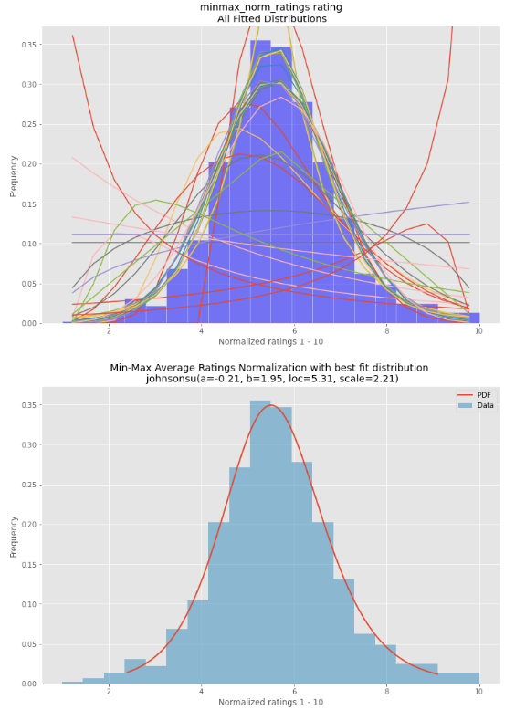
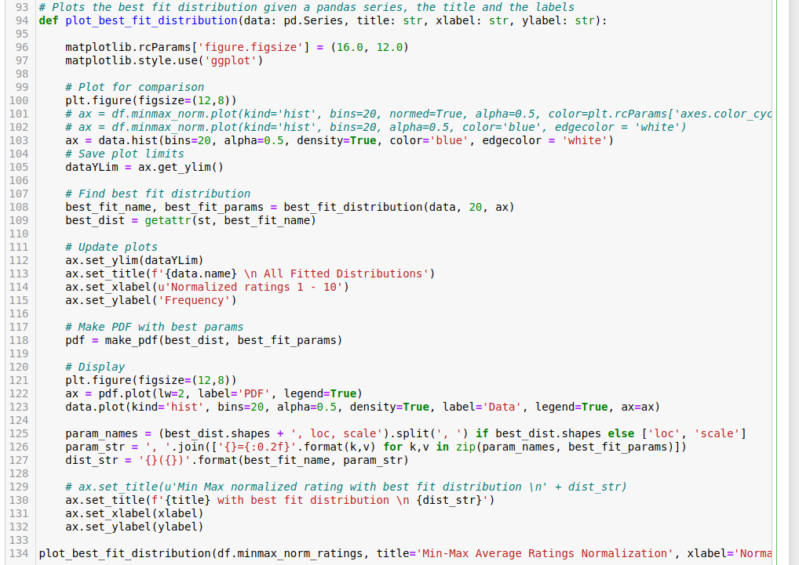
Minmax normalized ratings distributions
Notes:
Minmax normalized ratings
Graph above shows all possible lines of best fit
Graph below shows the best fit distribution
With Cleaned code

Slide 8
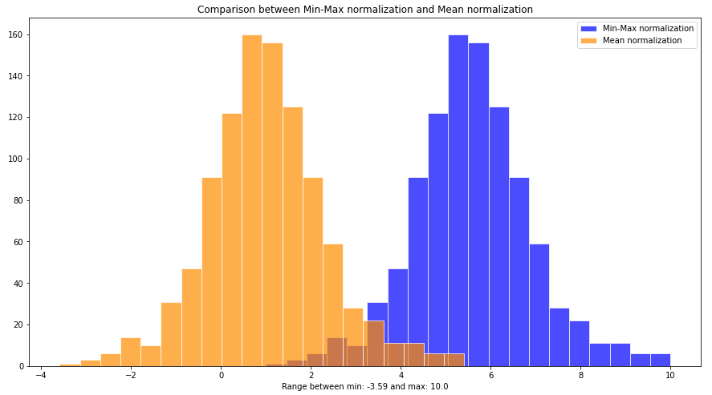
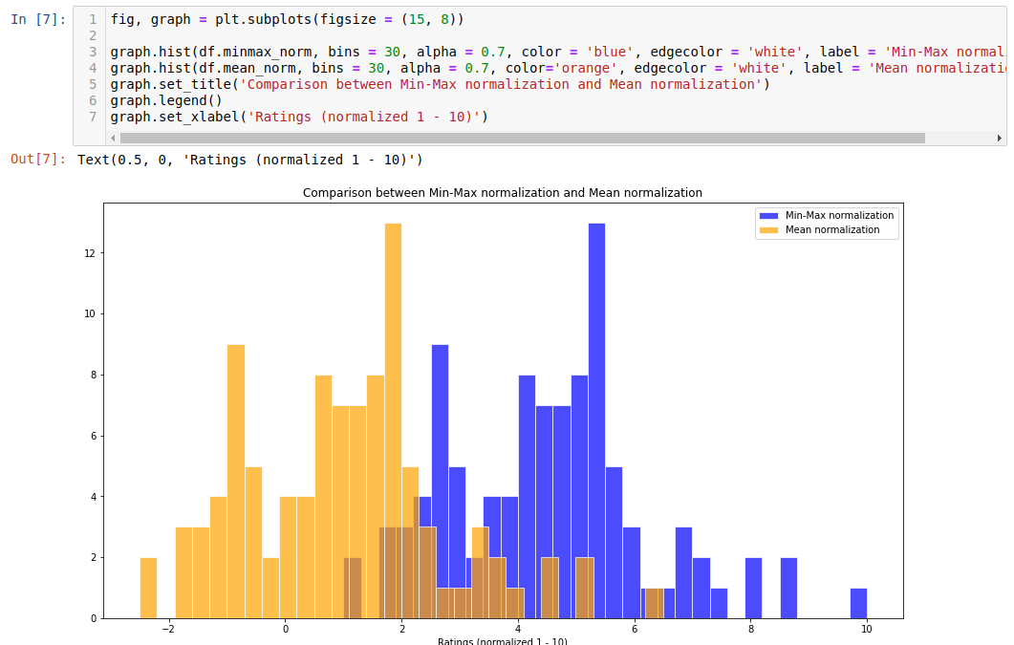
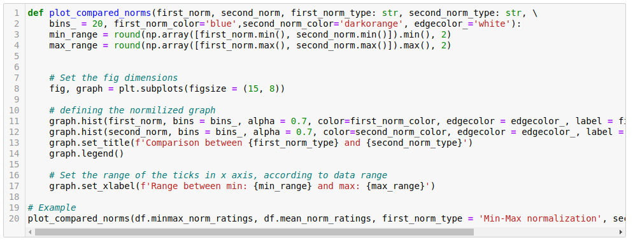
Comparison between minmax normalization and mean normalization.
Above is complex. Left is Concise
Notes:
Minmax normalization against mean normalization
The graphs show the same levels, shifted

Slide 9
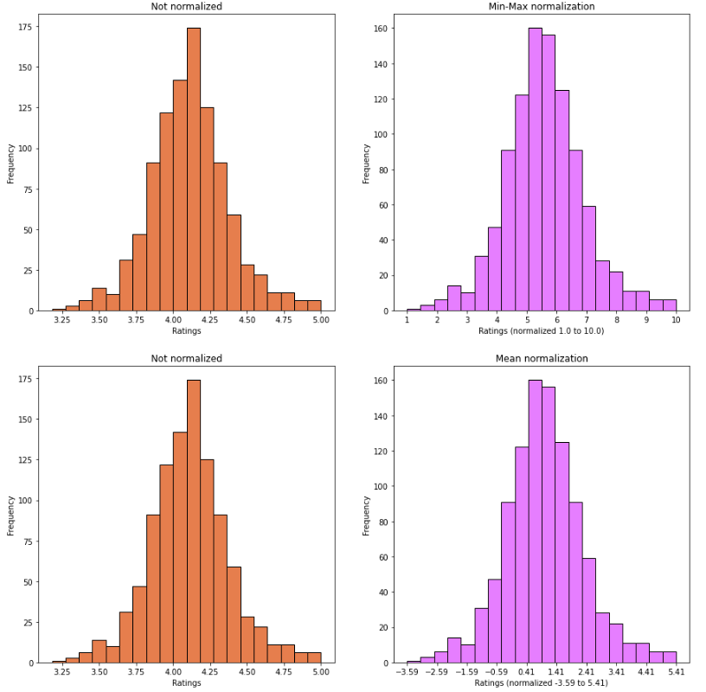
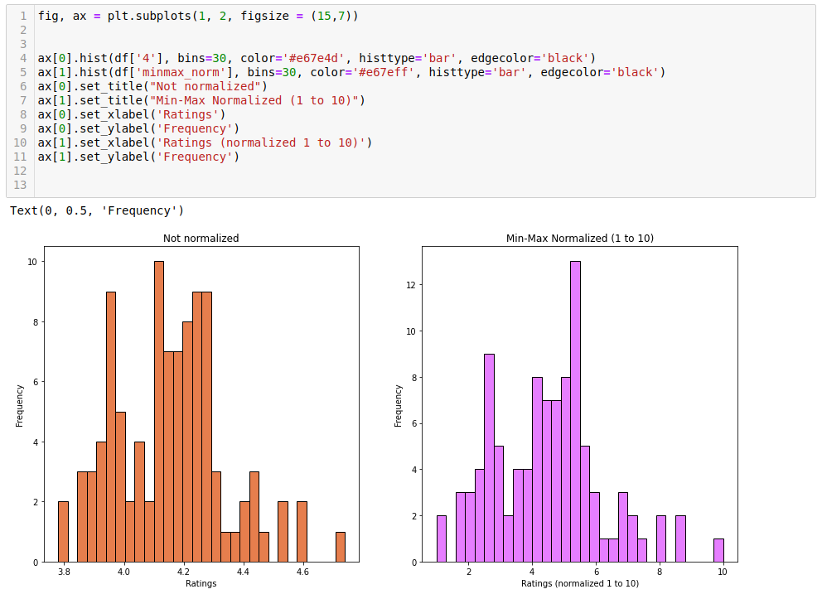
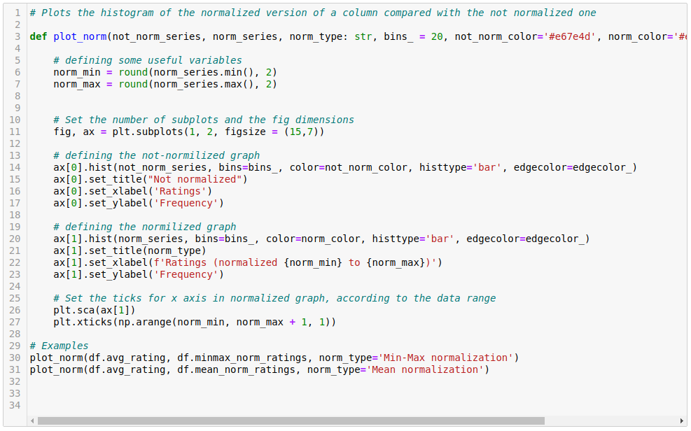
Average rating histograms. Not normalized vs minmax normalized (1 – 10)
Below is complex. Left is Concise
Notes:
Average ratings histograms, not normalized vs minmax normalized (1 – 10)
The left sides more complete visualization of the data shows both the minmax and mean, and both not normalized vs normalized
- Shows that the figures are identical when not normalized, and indecently in their changes when normalized

Slide 10
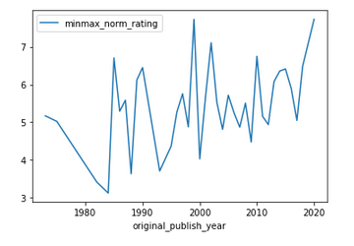
The original publishing year line graph
Notes:
Minmax normalization or ratings plotted against the original publishing year

Slide 11
Thank you for listening! Can’t wait to show you our new tool on Friday…

